Slide 1
Deletion of keys from B+ tree structure

Slide 2
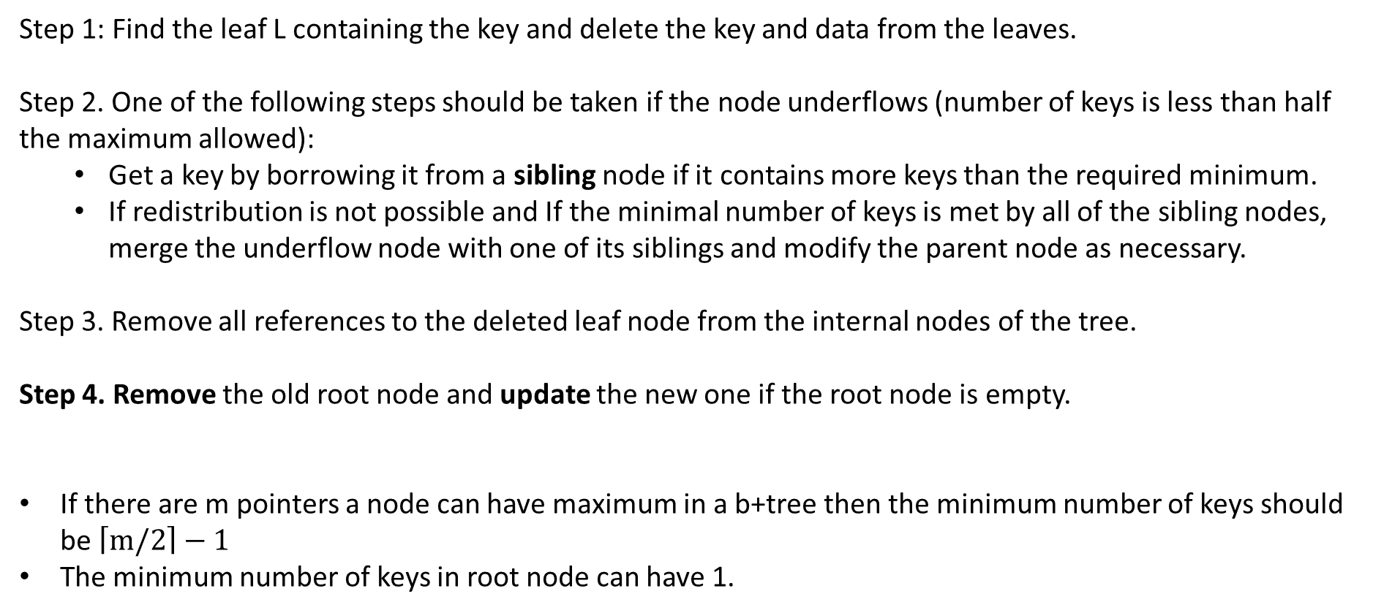
Step 1: Find the leaf L containing the key and delete the key and data from the leaves.
Step 2. One of the following steps should be taken if the node underflows (number of keys is less than half the maximum allowed):
Get a key by borrowing it from a sibling node if it contains more keys than the required minimum.
If redistribution is not possible and If the minimal number of keys is met by all of the sibling nodes, merge the underflow node with one of its siblings and modify the parent node as necessary.
Step 3. Remove all references to the deleted leaf node from the internal nodes of the tree.
Step 4. Remove the old root node and update the new one if the root node is empty.
If there are m pointers a node can have maximum in a b+tree then the minimum number of keys should be $\left\lceil m/2\right\rceil −1$
The minimum number of keys in root node can have 1.

Slide 3
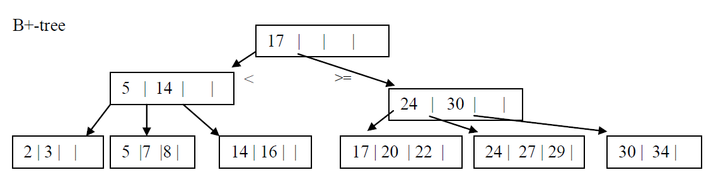
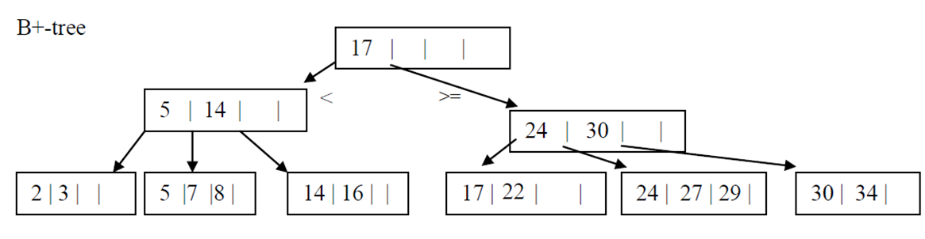
For the following B+-tree (m = 5) show the form of the tree after each of the of operations of the sequence:
Delete 20
Delete 20: Here we can very well delete the nodes since the minimum number of nodes that is 2 in this case remains.

Slide 4
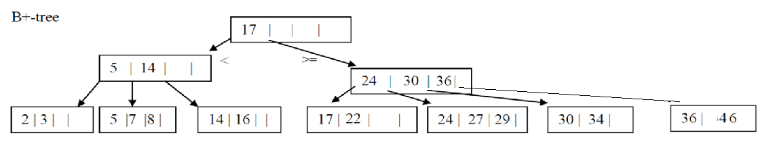
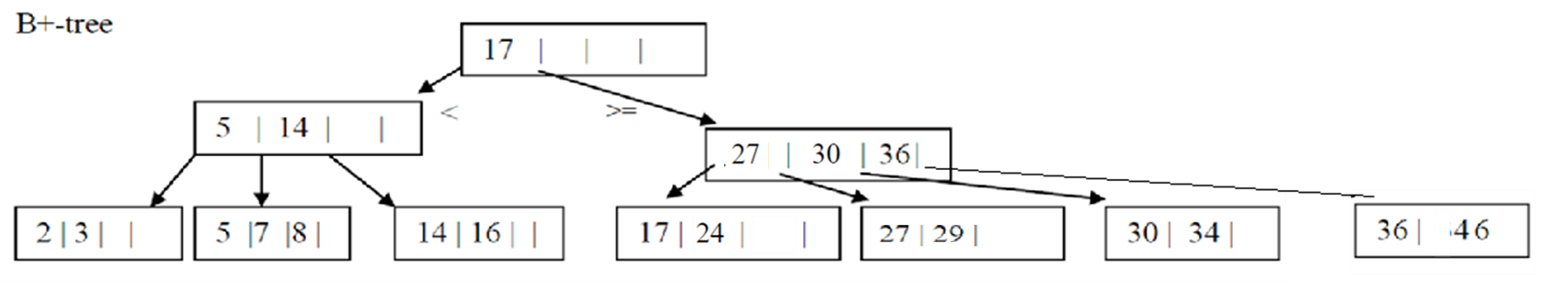
For the following B+-tree (m = 5) show the form of the tree after each of the of operations of the sequence:
Delete 22
Key distribution : Delete 22 : Upon deletion of the 22 the node contains only one key which less than the minimum required. So a key is borrowed (24) from the nearest neighbor. And the parent key value is updated as 27.

Slide 5
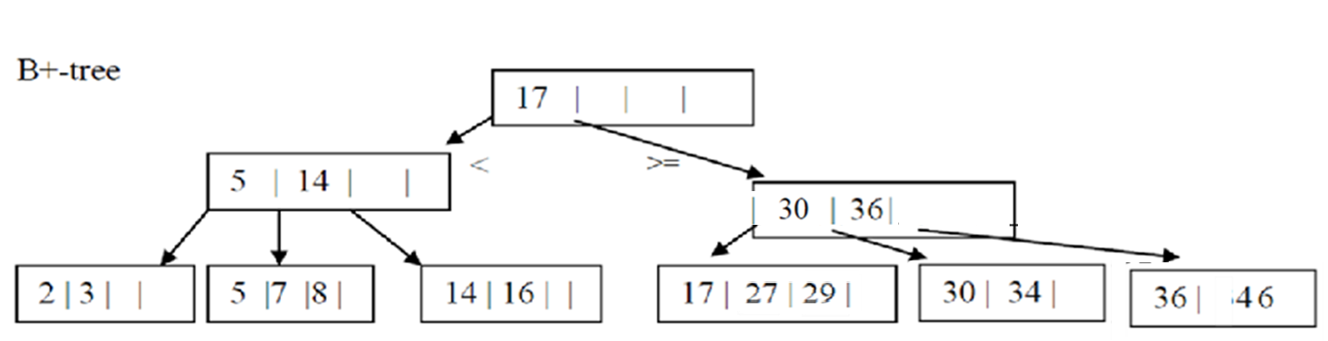
For the following B+-tree (m = 5) show the form of the tree after each of the of operations of the sequence:
Delete 24
Merging is happening of leaf nodes: Delete 24: when 24 is deleted the no of keys now in the node is less than 2, the minimum that is required. So a redistribution is tried first. But the nieghbor has no extra keys to redistribute. So the node is merged with the nearest node and the key 27 is deleted.

Slide 6
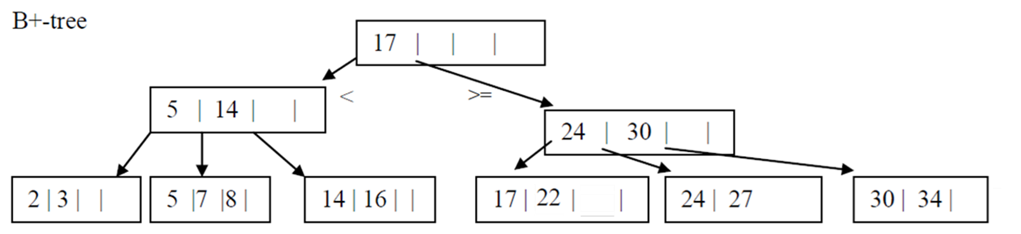
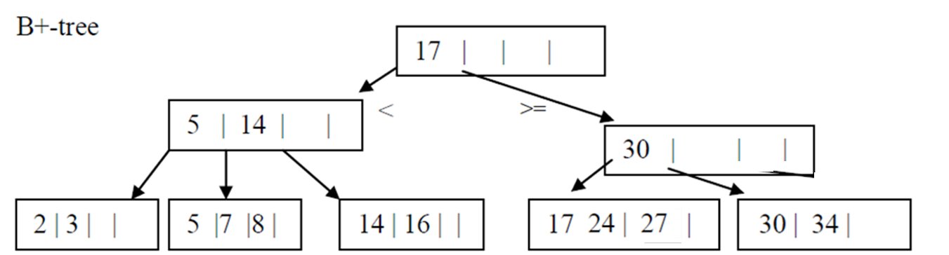
For the following B+-tree (m = 5) show the form of the tree after each of the of operations of the sequence:
Delete 22
Intermediate step 1: merging of nodes happen here but in that case the parent is left with only one node. And no borrowing or redistribution is possible here since the sibling has only two nodes 5 and 14.

Slide 7
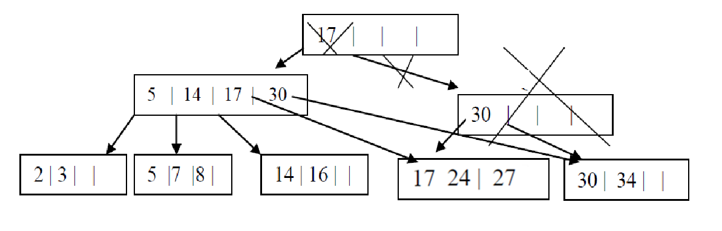
Intermediate step 2: non leaf merging: Thus, the node is merged along with root.

Slide 8
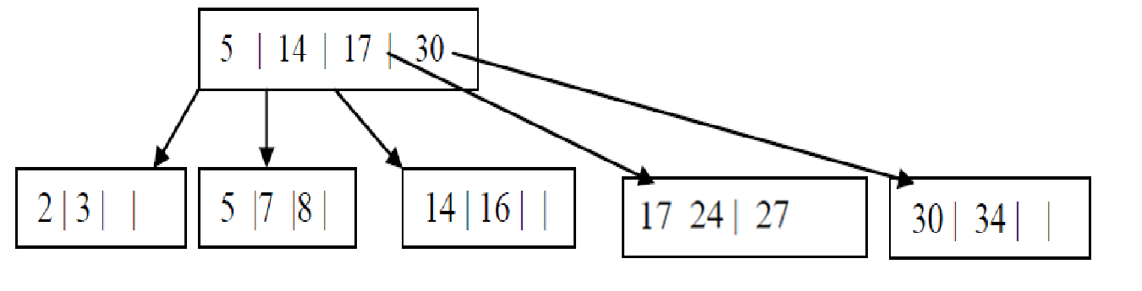

Slide 9
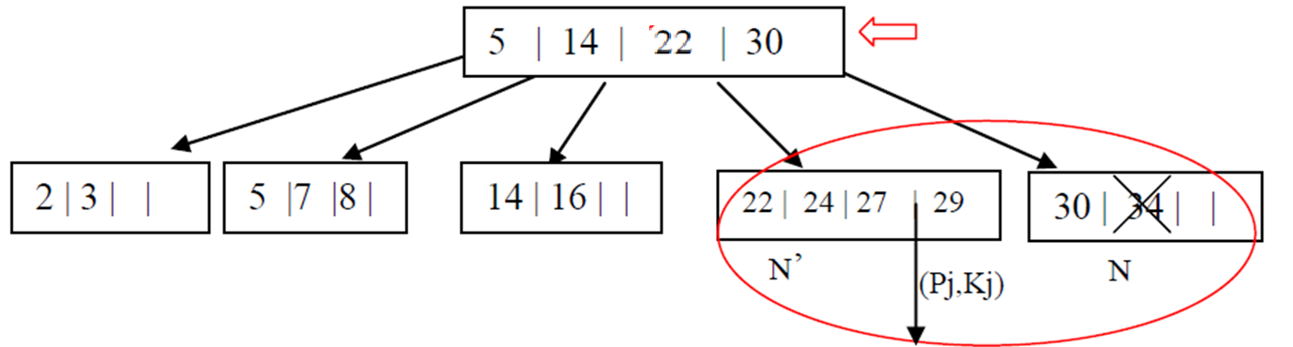
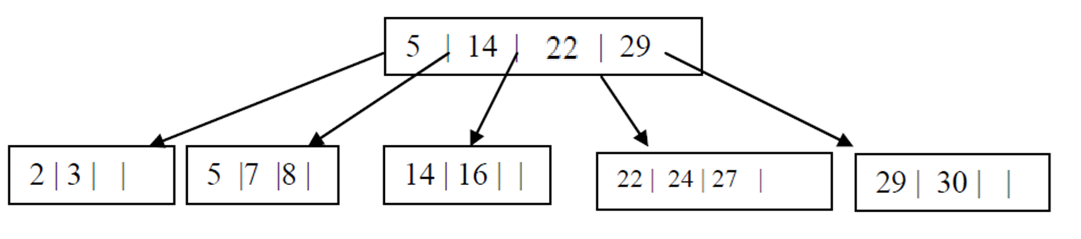
Keys redistribution: Delete 34

Slide 10
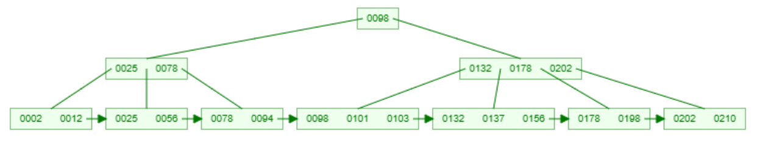
For the following B+-tree (m = 4) show the form of the tree after the operation: Delete 98

Slide 11
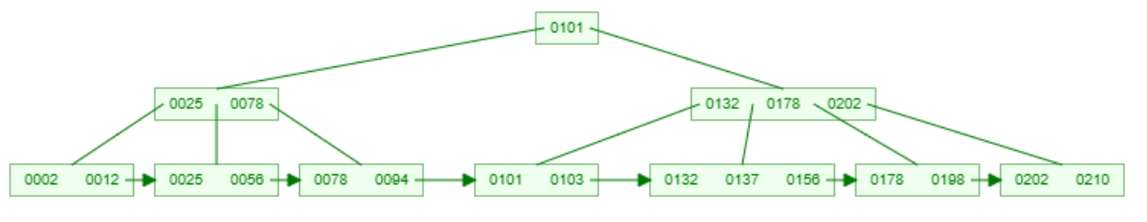
For the following B+-tree (m = 4) show the form of the tree after each of the of operations of the sequence: Delete 98
Here m = 4 so the minimum number of keys is $\left\lceil m/2\right\rceil −1$ = 1
Since 98 is also at root node, its deleted from the position and the least element from the right leg of the root node is chosen to be the new root node key

Slide 12
Delete 210

Slide 13
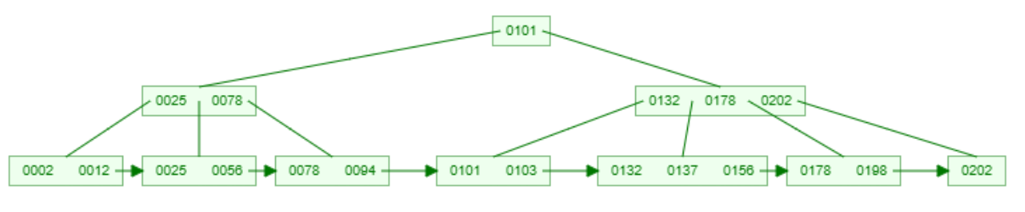
Delete 210
The key is deleted since it meets the minimality condition.

Slide 14
Delete 202

Slide 15
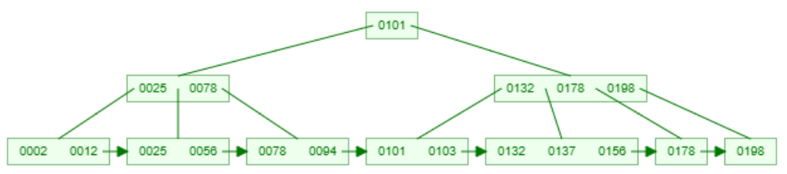
Delete 202
Key redistribution is happening here.

Slide 16
Delete 198

Slide 17
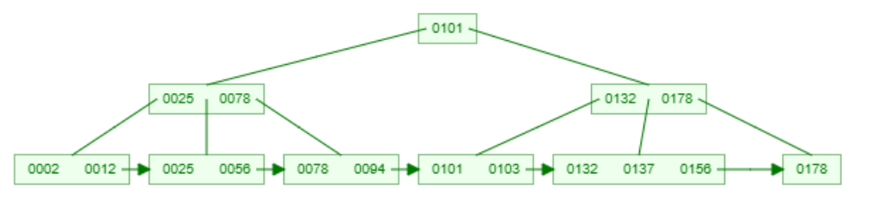
Delete 198
Merging is happening here.

Slide 18
Delete 78

Slide 19
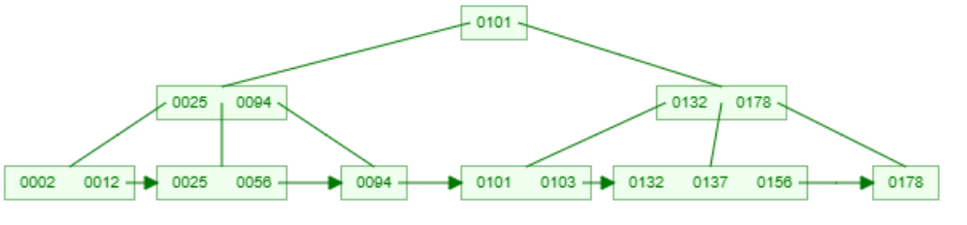
Delete 78
Simple delete along with update in the parent is happening here.

Slide 20
Delete 178

Slide 21
Delete 178

Slide 22
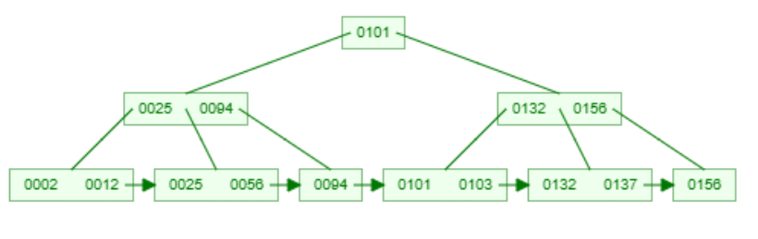
Delete 178
Key redistribution is happening here.

Slide 23
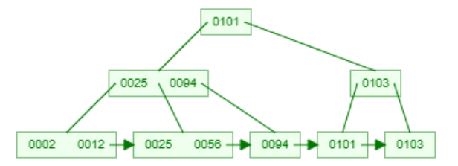
After much deletion operations we have the current B + tree now as below, Now perform Delete 103.
Merging is done here first but then no key remains in the parent of 101 key. So non leaf level redistribution happens and 94 is transferred to the root node and 101 to the right subtree as parent. Also the node with 94 on the left subtree is now transferred to the right subtree as a child of 101.

Slide 24
Delete 103

Slide 25
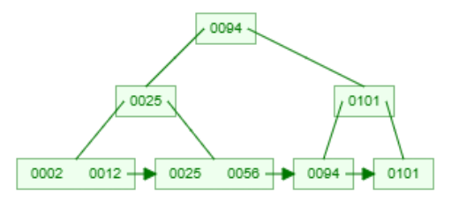
Delete 103

Slide 26
Delete 101
Merging happens here and since there is only minimum number of keys on the siblings of 94. Merging with parent happens here and the tree height decreases.

Slide 27
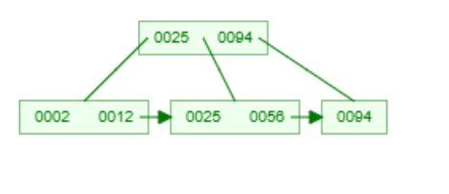
Delete 101

